Slide 1
Engineering Manual – Mysteries of Engineering Revealed
Paul C Czarapata
Navigating the Engineering Manual
08 April 2021

Slide 2
Where did the manual come from?
Problem with CERN quadrupoles built by FNAL causing damage to part of a string.
Director Pier Oddone asked that I look into what happened. (I refused death by power point review, so I held a working technical review.)
DOE insisted the lab bring in an outside company to do the same thing.
History at the lab had prototyping as a key element
Could not do it for a large, expensive magnet.
Information from CERN was incorrect! Vent back pressure was higher than stated.
Verbal communication to partner lab of change that was needed.
Verbal change request from partner lab to vendor. MISUNDERSTANDING and no follow up.
Outside company faulted the lab for not having an engineering manual.
DOE was also interested in the manual.
Group put together by Pier to develop a manual.
Originally we were told that LBL had a “black book” for engineering.
When I asked, the engineer at LBL said “what black book?”

Slide 3
Engineering Manual

Slide 4
Engineering Process at Fermilab
Project Requirements
Project
Engineering Manual covers bottom blocks
Systems
Assemblies
Sub-assemblies

Slide 5
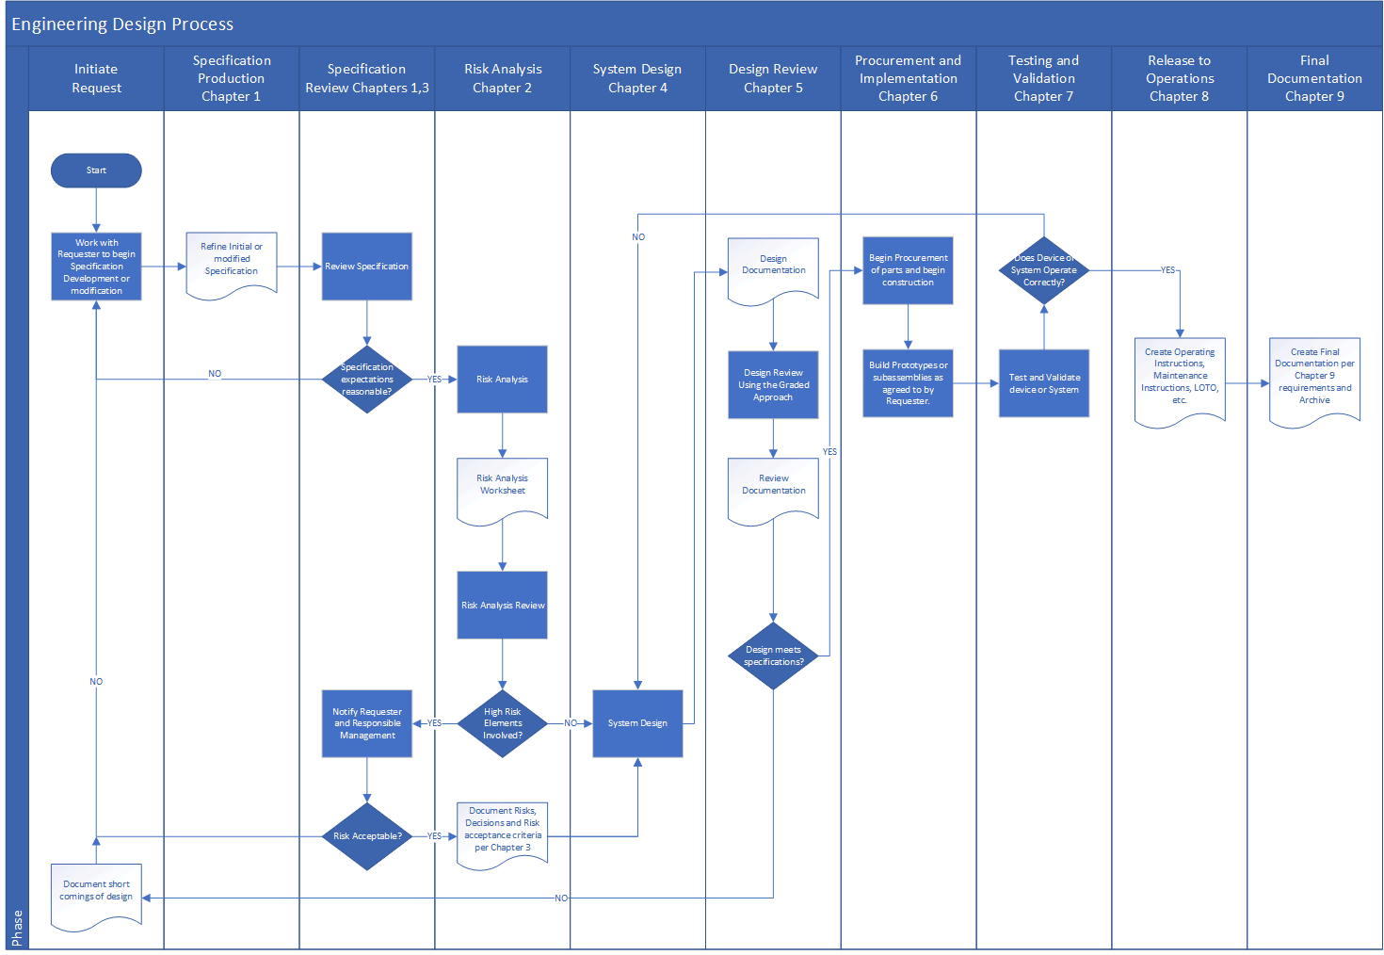
Engineering flow chart
This can be found on the Engineering Resource Guide at
https://ad.fnal.gov/EPG/
You can actually read it there too!

Slide 6
Contents
Introduction
Summary of Engineering Process
Chapter 1
Requirements and Specifications
Chapter 2
Engineering Risk Analysis
Chapter 3
Requirements, Engineering and Risk Analysis Reviews
Chapter 4
System Design
Chapter 5
Engineering Design Review
Chapter 6
Procurement and Implementation
Chapter 7
Testing and Validation
Chapter 8
Release to Operations
Chapter 9
Final Documentation
Appendix (hyper old!)
Has samples for each chapter

Slide 7
Critical Sections
These sections are critical to a successful design.
Chapter 1
Requirements and Specifications
Chapter 2
Engineering Risk Analysis
Chapter 3
Requirements, Engineering and Risk Analysis Reviews
Chapter 4 – DESIGN
Chapter 5 – THIS IS ONE OF THE LARGEST PROBLEMS WE HAVE Engineering Design Review.
Chapter 1 – “I told you what I wanted, and you didn’t give it to me. Now you’ve wasted all my project money! Your boss will hear about this!”
Chapter 2 – “I know I can get “Unobtainium sheets somewhere.”
Chapter 3 – “I know all there is to know on this subject, I’m sure I didn’t miss anything!” or “how can it not work… it’s only cutting-edge (bleeding edge) design.”

Slide 8
Risk Analysis – download a copy for your calculations

Slide 9
Risk Summary

Slide 10
Engineering and Project Risk Elements

Slide 11
Design
Don’t forget the Necessary and Sufficient requirements.
This is a list of all the Standards and rules we are required by our Contract to follow.
Things like the ASME Standards and National Electrical Code etc.
Engineering Design Reviews.
This is, in my opinion, the last line of defense we have.
The review team must be made up of knowledgeable Engineers (and sometimes Scientists) who can find the things we should not do in the design.
One that I still remember has to do with the use of grease in radioactive components.
Another is not taking into account the environmental conditions your design will work in for its lifetime.
Remember, a design review is not finding fault with you but trying to help you find things you may not have encountered yet no matter where you are in your career.
Don’t let a weak review condemn your project to failure.

Slide 12
So what is the Engineering Manual
Hopefully it is a commonsense method to approach design of a needed item.
Hopefully, it can keep you on track and out of trouble.
The approach works no matter how expensive or critical the item.
The Engineering Manual was developed by Fermilab engineers.
At the time it was written, there were no engineering manuals at any other National lab.
There are at least three other labs that have copied our manual and modified it for their use.
The Manual is not overly prescriptive, it provides what should be done in a graded approach fashion and you decide how to accomplish that.
Graded Approach.

Slide 13
More help
There is a new section on Transportation in the Risk Analysis.
This has not been finalized yet but will be soon.
There is also a new section on Reliability and Availability Calculations
The above two sections can be found on the Engineering Resource Guide.
https://ad.fnal.gov/EPG/
Check the resource guide out and if you have suggestions, contact me
pcceed@fnal.gov

Slide 14
Your Turn
Questions or comments?

